Slide 1
3.3 Data storage
Understand what is meant by primary storage • Primary storage is directly accessed by the CPU • Including the role of:
– random access memory (RAM)
– read only memory (ROM)
- Including why a computer needs both RAM and ROM, and the difference between them
Understand what is meant by secondary storage • Secondary storage is not directly accessed by the CPU and is necessary for more permanent storage of data
Describe the operation of magnetic, optical and • Magnetic storage uses platters which are divided solid-state (flash memory) storage and give into tracks and sectors. Data is read and written examples of each using electromagnets
Describe what is meant by virtual memory, how it is created and used and why it is necessary
Understand what is meant by cloud storage
Explain the advantages and disadvantages of storing data on the cloud in comparison to storing it locally
Optical storage uses lasers to create and read pits and lands
Solid-state (flash memory) uses NAND or NOR technology. Transistors are used as control gates and floating gates
Pages of data are transferred between RAM and virtual memory when needed
Cloud storage can be accessed remotely in comparison to storing data locally
Physical servers and storage are needed to store data in cloud storage

Slide 2
Today
Understand what is meant by primary storage • Primary storage is directly accessed by the CPU • Including the role of:
– random access memory (RAM)
– read only memory (ROM)
- Including why a computer needs both RAM and ROM, and the difference between them
Understand what is meant by secondary storage • Secondary storage is not directly accessed by the CPU and is necessary for more permanent storage of data
Describe the operation of magnetic, optical and • Magnetic storage uses platters which are divided solid-state (flash memory) storage and give into tracks and sectors. Data is read and written examples of each using electromagnets
Describe what is meant by virtual memory, how it is created and used and why it is necessary
Understand what is meant by cloud storage
Explain the advantages and disadvantages of storing data on the cloud in comparison to storing it locally
Optical storage uses lasers to create and read pits and lands
Solid-state (flash memory) uses NAND or NOR technology. Transistors are used as control gates and floating gates
Pages of data are transferred between RAM and virtual memory when needed
Cloud storage can be accessed remotely in comparison to storing data locally
Physical servers and storage are needed to store data in cloud storage
Understand: What is primary, secondary and offline memory
Able: Describe the features of primary memory
Answer: Explain what is fastest and why

Slide 3
Memory
For humans is things you can recall and remember
For computers is where you store information so you can get it later
Three types of memory
Primary Memory
Secondary Memory
Off-line storage

Slide 4
Primary / Secondary / Offline
Primary Memory / Primary Storage / Memory Kept inside in computer itself
Super Super Super quick
The CPU can access this memory directly
Secondary Memory / Secondary Storage
Holds data until you delete it
Slower than primary
The CPU cannot access directly
Large amount of storage
Offline storage
NOTHING to do with the internet
Means storage you can remove from a computer
USB flash drive
CD/DVD

Slide 5
Primary Storage
Kept inside in computer itself
Super Super Super quick
The CPU can access this memory directly
Two types of primary memory
RAM
Random Access Memory
ROM
Read Only Memory

Slide 6
RAM
Random Access Memory
Stores data that to be processed by programs
Volatile
Power off = data gone
Used in GENERAL PURPOSE COMPUTERS = normal computer
Also used in EMBEDDED COMPUTERS = calculator, digital watch, Air conditioner
General purpose may have lots of RAM because you need it to store lots of different data.
Embedded computers only need a few KB of RAM

Slide 7
DRAM and SRAM
There are two types of RAM.
DRAM and SRAM
DRAM = Dynamic Random Access Memory
SRAM = Static Random Access Memory
Both DRAM and SRAM are volatile. Which means when the power goes off everything is gone.
But SRAM keeps your data until you overwrite it.
DRAM forgets your data unless you continue to send it a signal.
SRAM is much faster than DRAM and is used for a CPU’s cache memory (Cache memory is around 1MB – 2MB and is located next to the CPU for super super quick access.
DRAM is a few GB and is what I’ve been showing you.
When people say RAM, they usually mean DRAM

Slide 8
ROM
Read Only Memory
You can only Read from this memory
Non-volatile
Stays forever
Tiny amount of memory
General purpose computer = hold the Bootstrap / BIOS
Embedded computer = holds the firmware
EPROM = Erasable Programmable Read Only Memory
ROM that can be erased and written to, for when you want to upgrade firmware / FLASH your firmware

Slide 9
Keywords
RAM
Random Access Memory
Volatile
ROM
Read Only Memory
Non-Volatile
General Purpose Computer
Normal Computer / Laptop
Can do many tasks
Embedded Computer
Calculator / Air conditioner
Can only do one thing
Firmware
ROM that holds program on embedded computer
Bootstrap
Rom that holds program on general purpose computer
EPROM
Erasable Programmable Read Only Memory
ROM that can be erased and re-written
Flashing
Name given when you erase and rewrite (EP)ROM

Slide 10
Data transfer
Regardless of what type of storage you use.
It will say its data transfer rate
Data transfer rate = How fast data can be moved to and from a device
Usually measured in MBps – Megabytes per Second

Slide 11
Magnetic Storage
Two types
Magnetic tapes
Hard drive

Slide 12
Magnetic Tape
Read, write and erase data
Uses electromagnetics to control tiny little magnetic dots of data
Has a READ head to read the magnetic charge of the dot.
Very cheap
Portable
Up to 185TB
Slow transfer speed (30MBps)

Slide 13
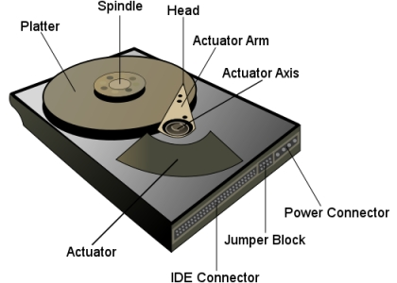
Hard Drive
Uses magnetic platters
Uses a read/write head to change the magnetic polarity
The platter spins and the head reads the surface of the platter
Very common
Large storage amount (8TB)
Cheap
Fast transfer speed (128MBps)
Internal

Slide 14
Hard drive
Okay both magnetic tape and hard drive use magnetic surfaces and an electronic head.
If a current is passed onto the electromagnetic head then the head can change the magnetic field on the tape / platter
Now one hard drive has a read write head which is attached to arm. The arm is controlled by an actuator.
And the actuator moves the arm, which moves the head, which looks at your platter.
But you may have many platters and many arms and many read/write heads inside one hard drive

Slide 15
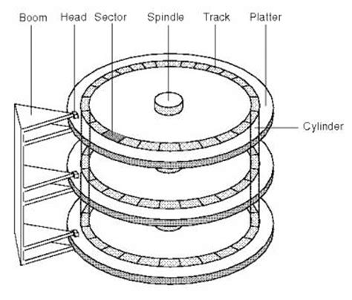
Ignore sector and track.
But look at how multiple platters have multiple heads.
The platters are centred around a spindle
A cylinder is where you get two (or more tracks) in the same location on different platters.
But WTF is a track?

Slide 16
Hard drive
Some terms
Track Sector
The smallest unit of your hard drive (usually 512bytes)
Disk Sector
A wedge shape / pizza shaped slice of sectors from the centre to the edge
Cluster
A group of sectors
Track
A group of sectors that make a full circle
When you store a file, you don’t need to make sure the information in your files are stored next to each other. They can be in different sectors – it’ll be better and faster if they were next to each other but no big deal.

Slide 17
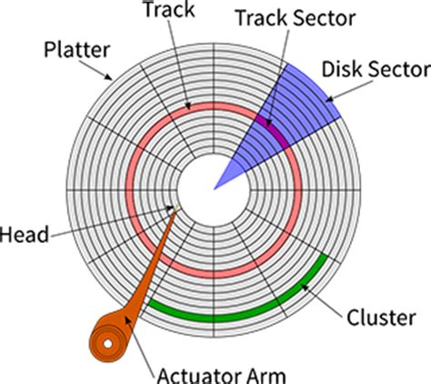
What are these parts?
A
B
G
C
F
D
E

Slide 18


Slide 19
Solid State
+ More modem
+ No moving parts, so more reliable
+ Faster because you don’t have to wait for a head or platter to move
+ Less power consumption
+ Lighter in weight so laptops can be lighter
- Becoming cheaper but still a bit expensive
- Lifespan is still a concern.
USB sticks
Solid State Drive (SSD)
SD Card

Slide 20
Solid State
Solid state drives work by storing electrons in millions of tiny transistors
Transistor = Really small device that allows electricity to pass through
There are two main types of SSD
(Right….. This bit is stupid and pointless but Cambridge wants us to know it)
NAND flash SSD
NOR flash SSD
When we do logic gates, we will talk more about NAND and NOR.
For now, just remember that:
Both types store data in transistors
NAND is the most popular
When you delete from NAND, you delete in blocks of data
When you delete from NOR, you can delete individual bytes (8 bits)
This means NOR can be more flexible, but more expensive
NOR is used when you want EEPROM
EEPROM = Electronically Erasable Programmable Read Only Memory

Slide 21
Today
Understand what is meant by primary storage • Primary storage is directly accessed by the CPU • Including the role of:
– random access memory (RAM)
– read only memory (ROM)
- Including why a computer needs both RAM and ROM, and the difference between them
Understand what is meant by secondary storage • Secondary storage is not directly accessed by the CPU and is necessary for more permanent storage of data
Describe the operation of magnetic, optical and • Magnetic storage uses platters which are divided solid-state (flash memory) storage and give into tracks and sectors. Data is read and written examples of each using electromagnets
Describe what is meant by virtual memory, how it is created and used and why it is necessary
Understand what is meant by cloud storage
Explain the advantages and disadvantages of storing data on the cloud in comparison to storing it locally
Optical storage uses lasers to create and read pits and lands
Solid-state (flash memory) uses NAND or NOR technology. Transistors are used as control gates and floating gates
Pages of data are transferred between RAM and virtual memory when needed
Cloud storage can be accessed remotely in comparison to storing data locally
Physical servers and storage are needed to store data in cloud storage
Understand: What is optical storage
Able: Describe the features of optical storage
Answer: Why can Blu-ray store more data?

Slide 22
Optical Storage
Little bit similar to a hard drive
Uses plastic discs (not magnetic like hard drives)
A laser burns the disc (a hard drive uses magnets)
When a laser burns the disc its called a pit
Where there is no pit its called land
Pit |  | Land | Pit | Land |  |  | Pit
1 | 1 | 0 | 1 | 0 | 0 | 0 | 1

Slide 23
Optical Storage
Different types of Optical Storage
CD - Compact Disc
DVD – Digital Versatile / Video Disc
Blu-ray Disc
Blu-ray uses a blue-violet laser that has a shorter wavelength than a normal red laser. Because the wavelength is smaller, you can be more accurate and fit more data in the same area.
Type | Capacity
CD | 700MB
DVD single layer | 4.7GB
DVD dual layer | 9.4GB
Blu-ray single layer | 25GB
Blu-ray dual layer | 50GB
Blu-ray triple layer | 100GB
Blu-ray quadruple layer | 125GB

Slide 24
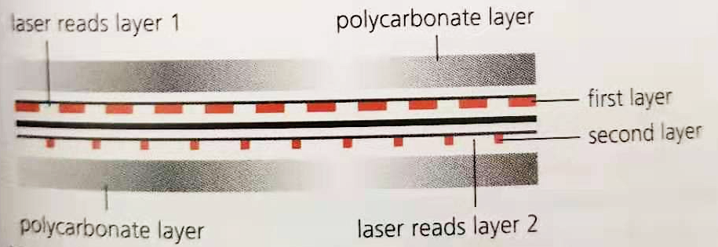
Dual Layer
Dual layer just means that there are two layers used.
So imagine a normal CD /DVD and now add another recording layer on to it, that’s dual layer. Same physical size as a single layer but can store twice the amount.
The layers are joined together with a polycarbonate spacer and a small reflector.
When the laser burns pits on one layer, it leaves a tiny gap so if it needs to burn something in the second layer it can.

Slide 25
Types of optical storage:
So we have CD, DVD and Blu-Ray.
But within them we have different types
Each type has a different suffix
** ROM = Read Only. Data is already burned on the disc when you get it
** R = Disc is empty but you can write to it ONCE
** -RW = Empty to start with, you can read and write to it many times
** +RW
** RAM

Slide 26
-RW and +RW
You can have DVD –RW and DVD +RW (You also have DVD –R and DVD +R)
Both say R or RW.
R = Read Only
RW = Rewriteable
But what's the difference between the + and the –
Well, it was first made because some companies wanted one way and other companies wanted the other way
DVD-RW: Pioneer, Toshiba, Hitachi, and Panasonic,
DVD+RW: Sony, Philips, Hewlett-Packard, Ricoh, and Yamaha.
With the ‘-’ it reads the land as to where to align the data
With the ‘+’ it sees the wobble of the laser as it passes over puts to align the laser
Now, both can be used because every drive can read both types

Slide 27

Optical storage circles
Every ROM, R and RW has data stored in a spiral circle.
This means there is a track that starts in the middle and moves outwards

Slide 28

Optical Storage Circles (part 2)
We also have DVD RAM
This does not store data in a spiral
This stores data in concentric circles
This means you can read and write to the disk at the same time
It makes them good for storing data for a long time (as long as you keep the disk in good condition)

Slide 29
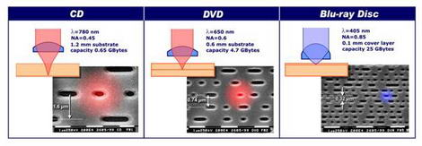
Blu-Ray
We said before that Blu-ray can store more data because it uses a blue / violet light which has a shorter wavelength
A red laser is 650nm (nanometres)
A blue laser is 405nm

Slide 30
Blu Ray lie
Your Hodder coursebook will say that Blu-ray is single layer.
It says its single layer because otherwise the light will refract and interfere with another layer if it had the other layer.
This is called Bireferencing
Birefrecning is true, but them saying Blu-ray is single layer only is false.
You can buy Blu-ray dual layer discs
Called BL DL

Slide 31
But how can you rewrite a CD?
A normal CD has a shiny surface which the laser burns.
But you can burn once and that’s it
A rewritable CD has another special surface on top of the shiny layer.
It’s a special dye
The laser shines on this dye and then it makes this dye transparent. Then it can show the shiny surface underneath.
To make the surface cloudy again the laser shines again but at a different temperature to make the dye cloudy

Slide 32
Today
Understand what is meant by primary storage • Primary storage is directly accessed by the CPU • Including the role of:
– random access memory (RAM)
– read only memory (ROM)
- Including why a computer needs both RAM and ROM, and the difference between them
Understand what is meant by secondary storage • Secondary storage is not directly accessed by the CPU and is necessary for more permanent storage of data
Describe the operation of magnetic, optical and • Magnetic storage uses platters which are divided solid-state (flash memory) storage and give into tracks and sectors. Data is read and written examples of each using electromagnets
Describe what is meant by virtual memory, how it is created and used and why it is necessary
Understand what is meant by cloud storage
Explain the advantages and disadvantages of storing data on the cloud in comparison to storing it locally
Optical storage uses lasers to create and read pits and lands
Solid-state (flash memory) uses NAND or NOR technology. Transistors are used as control gates and floating gates
Pages of data are transferred between RAM and virtual memory when needed
Cloud storage can be accessed remotely in comparison to storing data locally
Physical servers and storage are needed to store data in cloud storage
Understand: What is virtual memory
Able: Describe different paging methods
Answer: What are the disadvantages of cloud storage?

Slide 33
Other types of memory / storage
Virtual Memory
Cloud
Notes:
Describe what is meant by virtual memory, how it is created and used and why it is necessary
Understand what is meant by cloud storage
Explain the advantages and disadvantages of storing data on the cloud in comparison to storing it locally
Pages of data are transferred between RAM and virtual memory when needed
Cloud storage can be accessed remotely in comparison to storing data locally
Physical servers and storage are needed to store data in cloud storage

Slide 34
Virtual Memory
What is faster, your Hard Drive or your RAM??
RAM, RAM is faster, but RAM is volatile
So we store all our programs and files in our hard drive, even though its slow, it keeps the data (non-volatile)
But when we want to use a program, like Photoshop, or Word, or Firefox… anything…
The OS takes the instruction and loads the program from your hard drive and puts it in your RAM.
Why?
Because it knows you are probably going to want to access that program often and therefore RAM is quicker to communicate with

Slide 35
1. Memory Management
Wait…Mr.. Amar, I have a game and its 100GB and I have 4GB of RAM, my game runs fine, how can 100GB fit into 4GB? Stupid.
You are wrong and right.
There have been different ways that the Memory Manager in the OS uses RAM to store data.
Single Contiguous
Fixed Partitions
Dynamic Partitions

Slide 36
Memory Management Methods
Single contiguous
Only one thing can be in RAM at any time
If there is not enough space in RAM then it cannot run
Real stupid way
Slow
Might not be able to run everything you need
PROGRAM
RAM
RAM
PROGRAM

Slide 37
Fixed Partitions
Because single contiguous is stupid, fixed partitions was made.
Your OS splits up your RAM into different parts. These parts are called partitions
If your program can fit in one of these partitions then great.
It means you have more than one program in RAM at the same time
If your program cannot fit, then too bad, it can’t run.
The size of each partition is fixed. If you need a bigger partition then you have to turn off your computer and reset the partition size in your OS. – Super annoying
RAM
PARTITION 1
PARTITION 2
PARTITION 3
PARTITION 4

Slide 38
Dynamic Partitions
So if fixed partitions had fixed partitions, what do you think dynamic partition means?
The partitions can change size. They are dynamic.
Actually it’s a stupid term because there are no partitions.
Your RAM starts off as empty.
Your program says “I want 20mb”
If your RAM has 20mb free, then it goes in.
The next program says “I want 300mb”
If there’s space, then it goes it.
This continues until your RAM is full and then it refuses anything else.

Slide 39
Don’t trick me
No, no, no, Mr. Amar, you are smart, speak well, handsome, charming, stylish, rich, strong and modest – but my question was not answered.
I have 100GB game, only 4GB of RAM, and no matter what I use, single contiguous, fixed partitions or dynamic partitions, I can still run out of RAM.
Yes. This is true…..
I am smart, speak well, handsome……..
But for memory, if your OS has no more RAM then it uses Virtual Memory.
Virtual Memory = When your OS uses your hard drive as if it was RAM

Slide 40
Video Questions (8 min video)
Can single contiguous hold multiple jobs?
Why does fixed partitions use a table?
What’s the name of this table?
How many ways do fixed and dynamic partition methods use to allocate jobs?
Explain First Fit
Explain Best Fit
What is deallocation?
What are pages?
What are page frames?
In paged memory allocation, do the pages have to be next to each other?
What are the names of the three tables in paged memory allocation
What’s demand paging?
What does status show in demand paging?
Name two replacement policies for demand paging?
Name another two polices for demand paging?
What is segmented memory allocation?
Does it still use a page map table?

Slide 41


Slide 42
Video Questions (8 min video)
Can single contiguous hold multiple jobs?
Why does fixed partitions use a table?
What’s the name of this table?
How many ways do fixed and dynamic partition methods use to allocate jobs?
Explain First Fit
Explain Best Fit
What is deallocation?
What are pages?
What are page frames?
In paged memory allocation, do the pages have to be next to each other?
What are the names of the three tables in paged memory allocation
What’s demand paging?
What does status show in demand paging?
Name two replacement policies for demand paging?
Name another two polices for demand paging?
What is segmented memory allocation?
Does it still use a page map table?

Slide 43
Disk Trashing
One thing the video did not talk about was ‘disk trashing’
Say you got a page in RAM and a page on your virtual memory (hard drive)
Your page in RAM needs to access the page on your hard drive. It does this.
But now you page in hard drive needs to load something from RAM
And now RAM needs something from hard drive again
And now hard drive needs to load from RAM again
And now you are stuck loading and unloading pages.
This is disk trashing
It doesn’t happen so often but its in your course book so we should mention it

Slide 44
Cloud
This is where you store your data online.
But saying online is a little stupid.
What you are actually doing is storing your data on a server, its just that the sever is not yours, it belongs to Google (Google Drive), Microsoft (OneDrive), Baidu (Baidu Pan)
+ Can access data from any device as long as you have internet
+ Offline (so you don’t have to worry about keeping it safe)
Slower than local storage
You have to trust Google, Microsoft, Baidu……
Usually pay each month

Slide 45
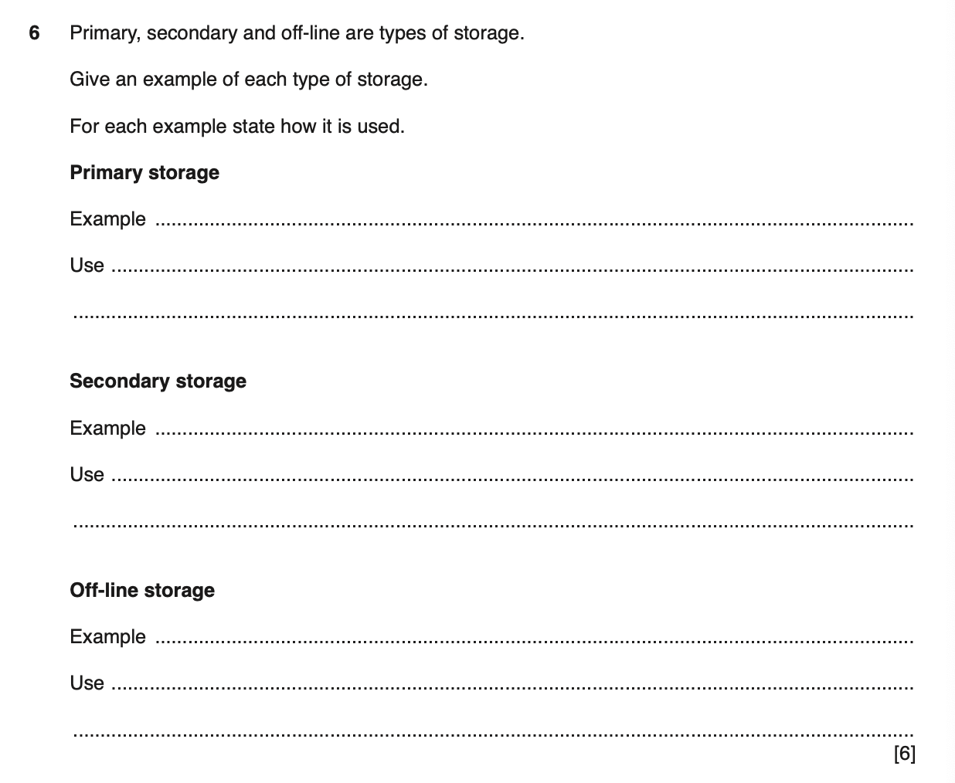
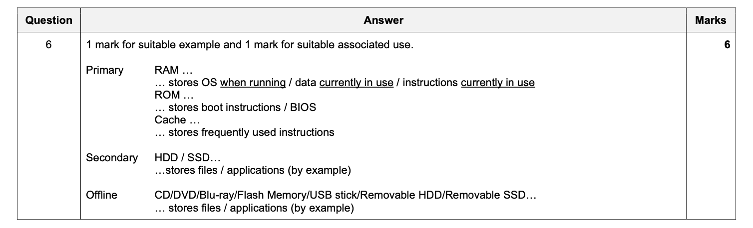

Slide 46
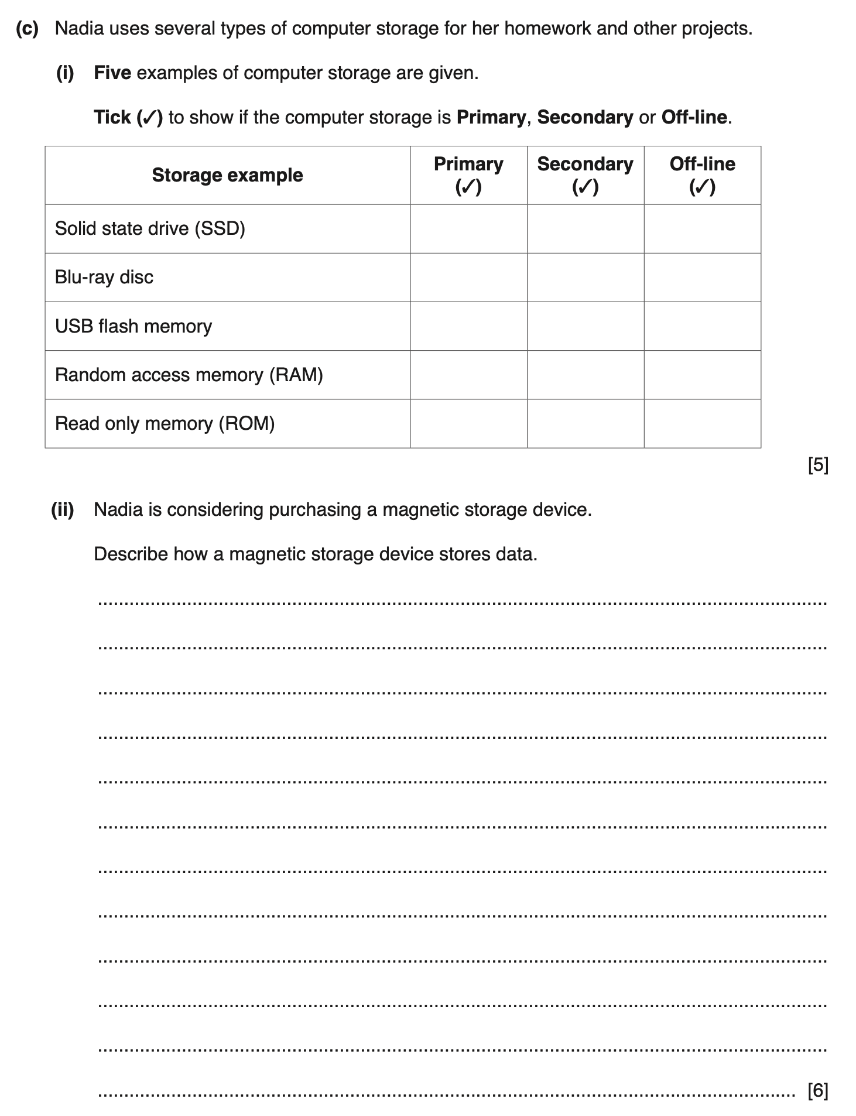
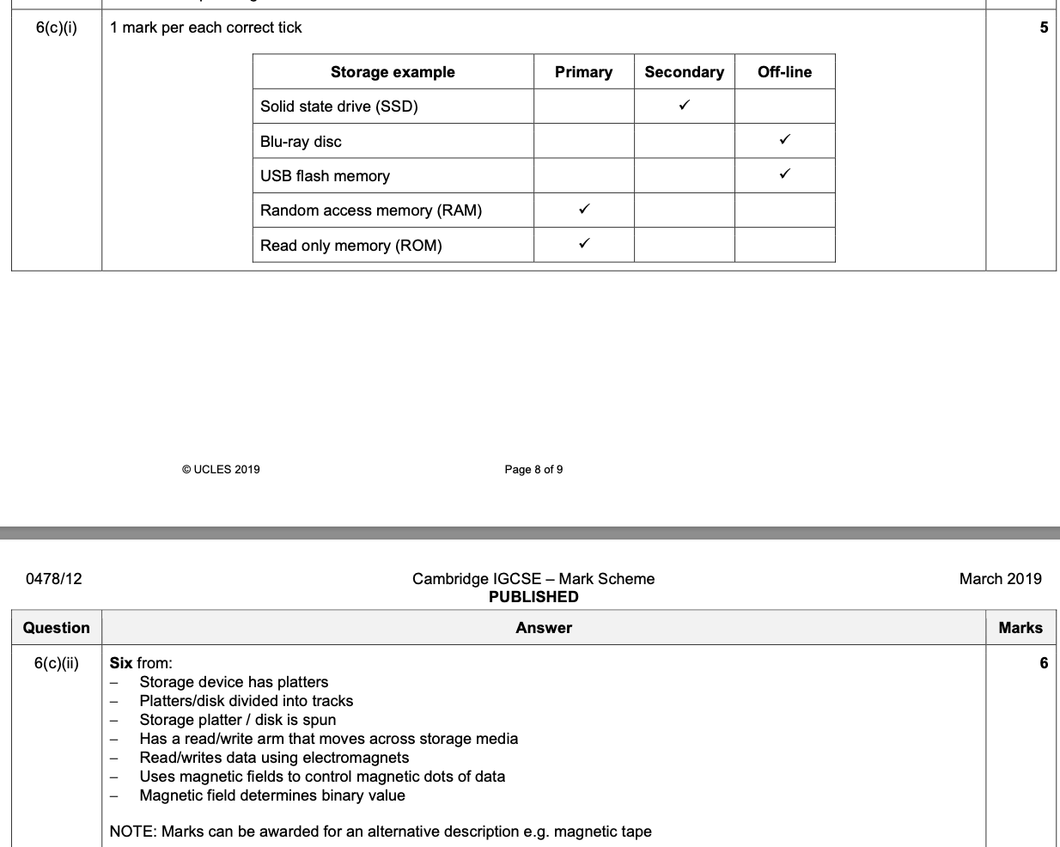

Slide 47
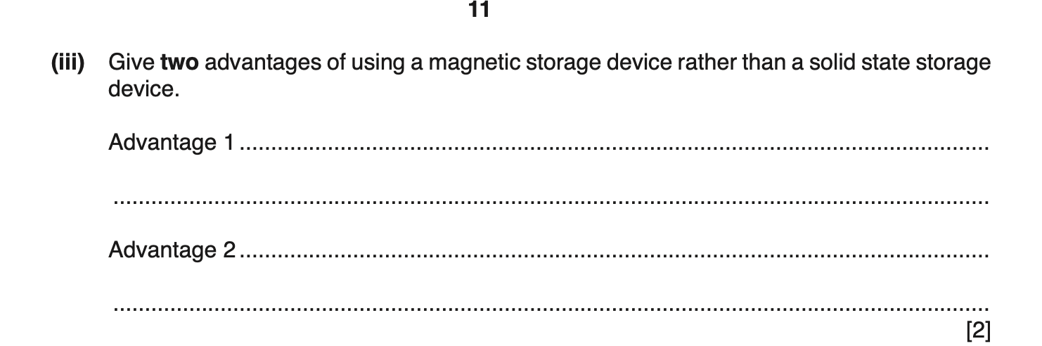

Slide 48
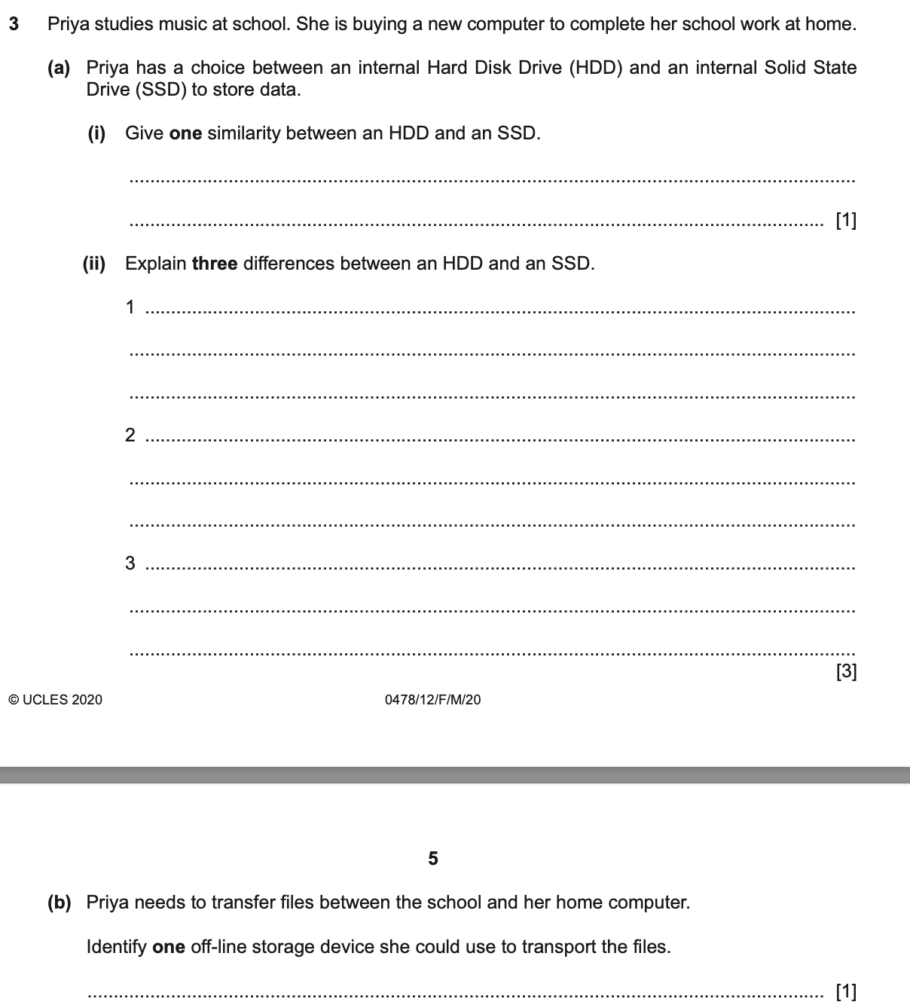
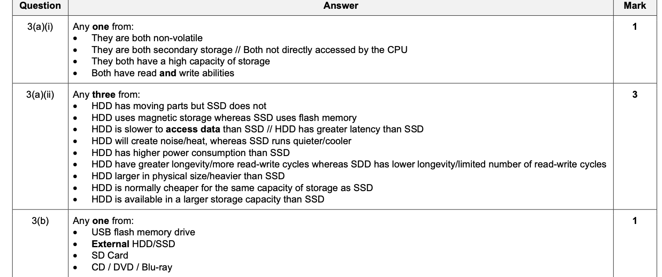

Slide 49
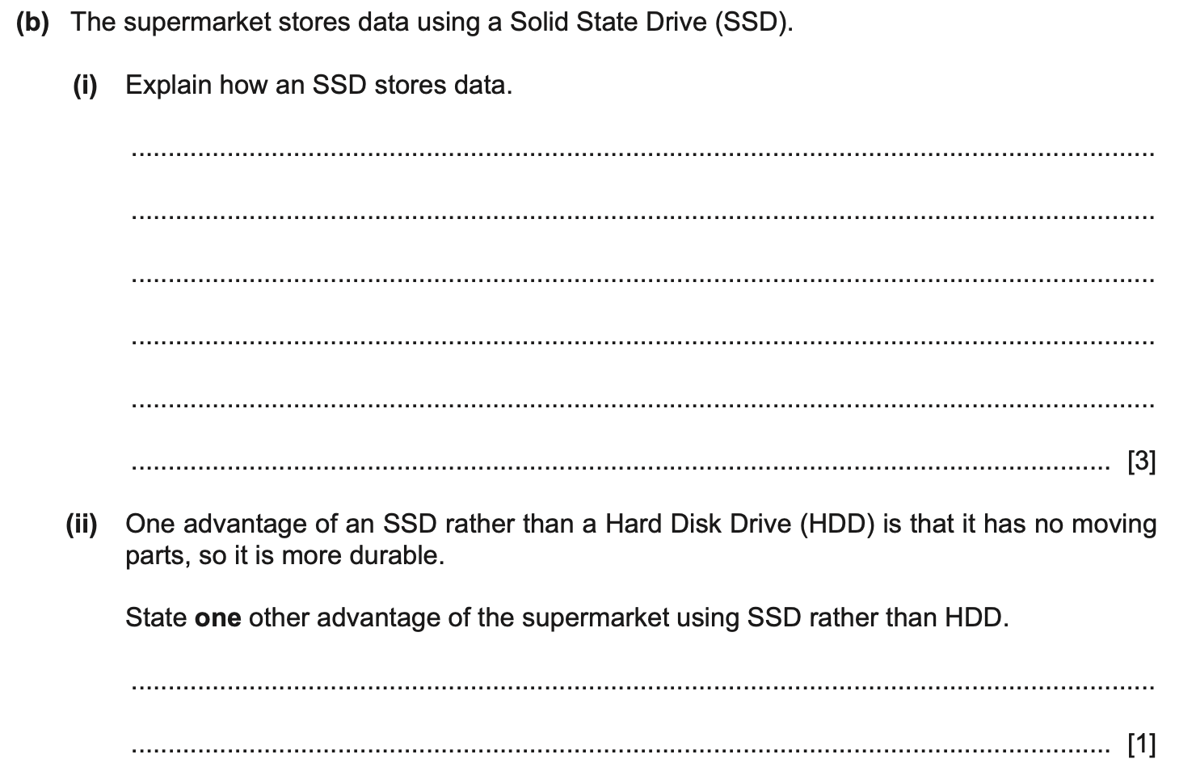
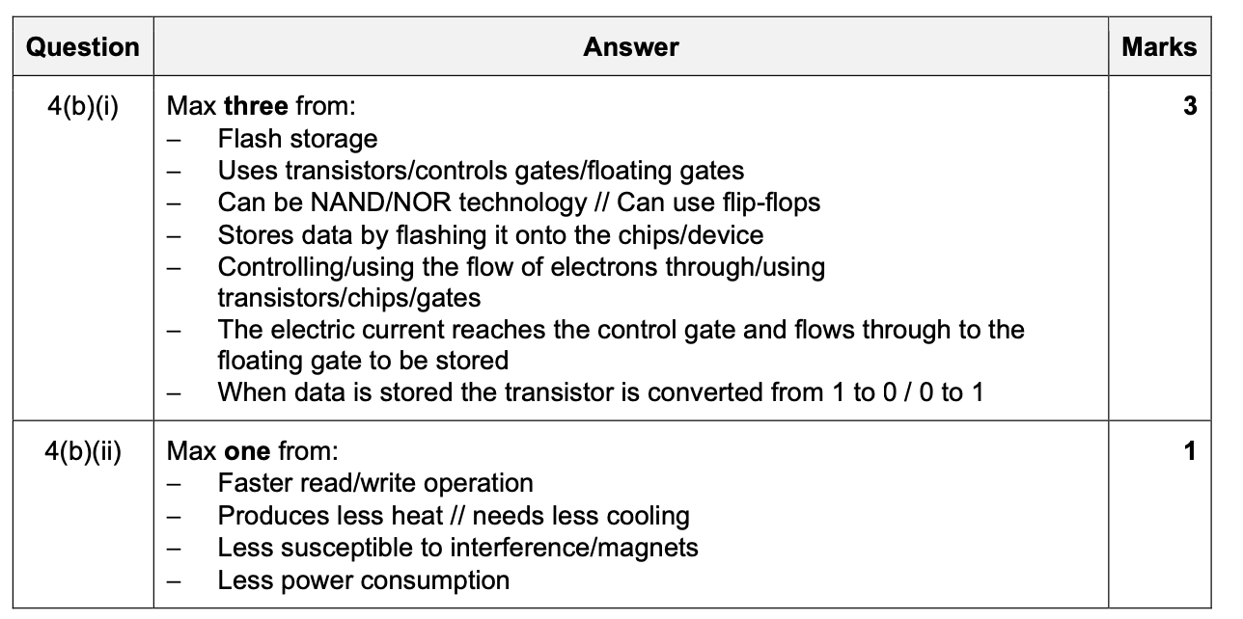

Slide 50
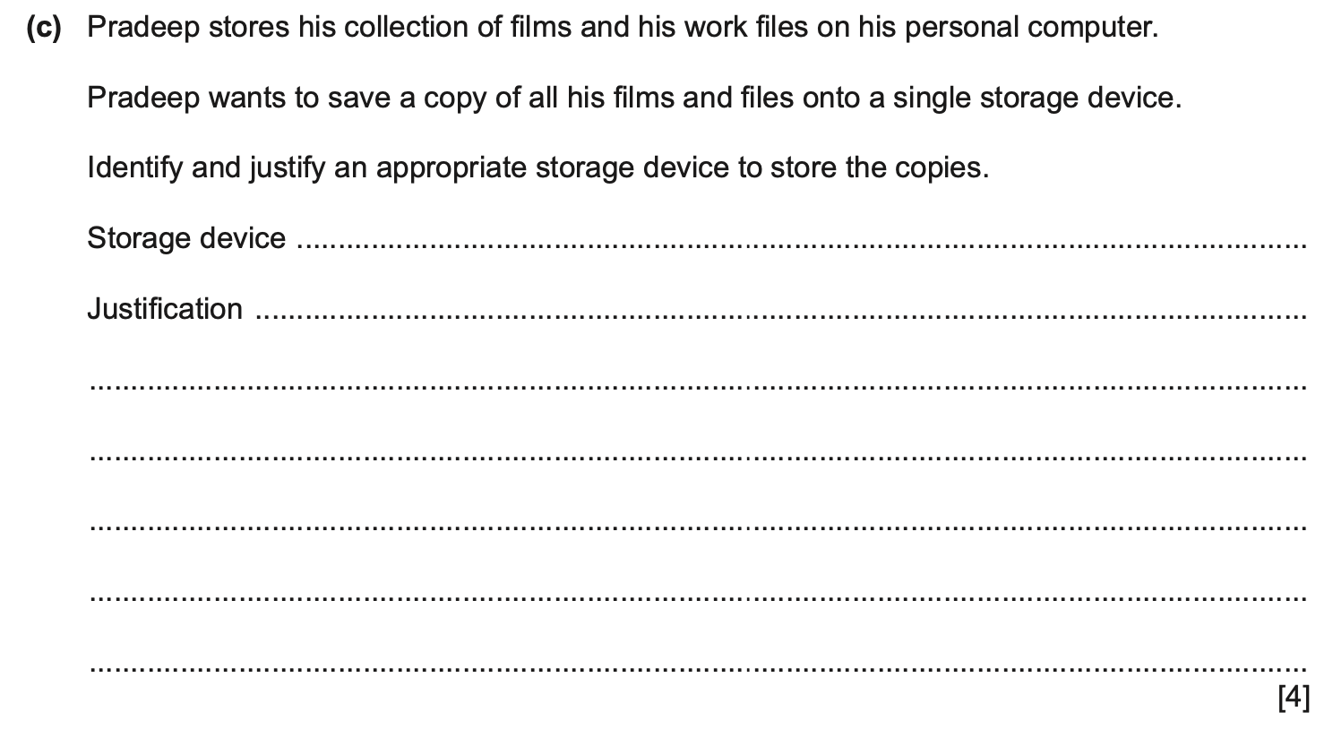
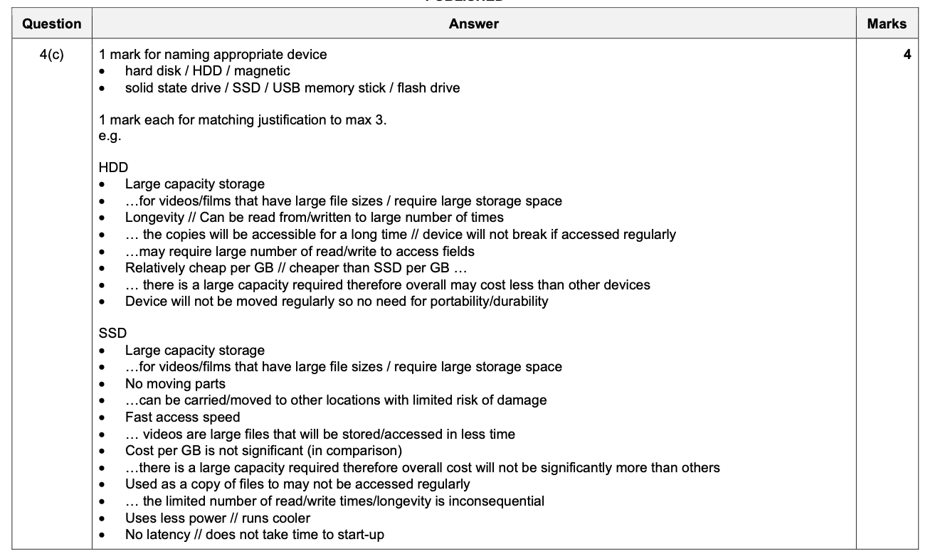

Slide 51
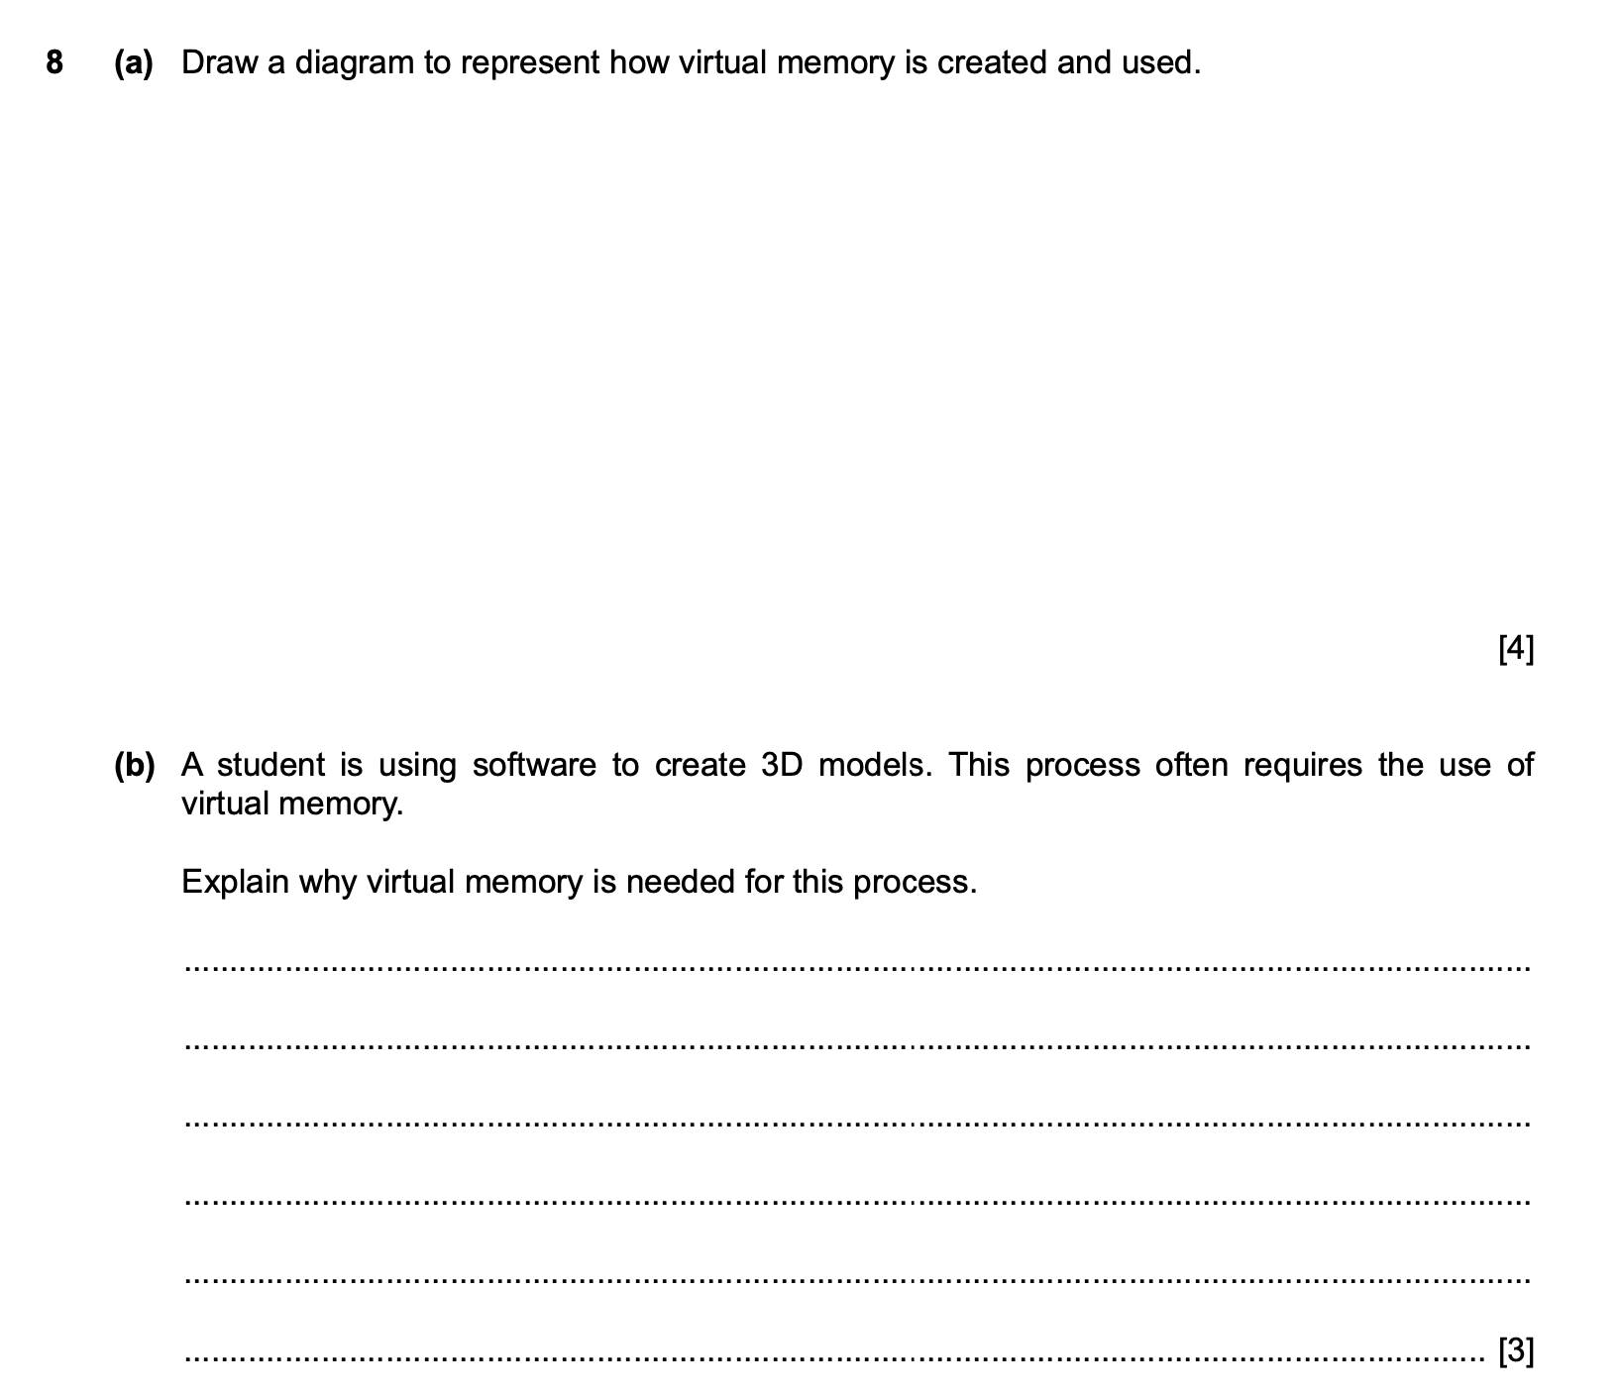
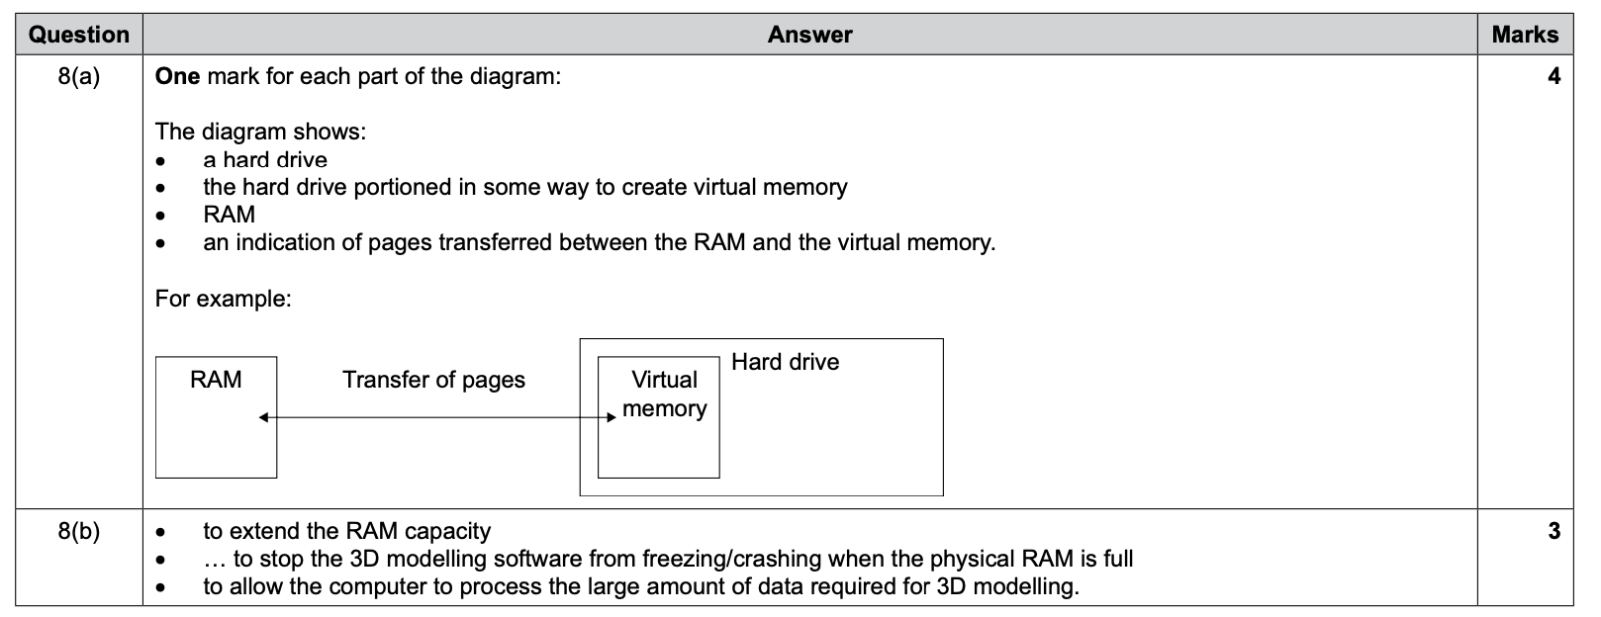

Slide 52
